Slide 1

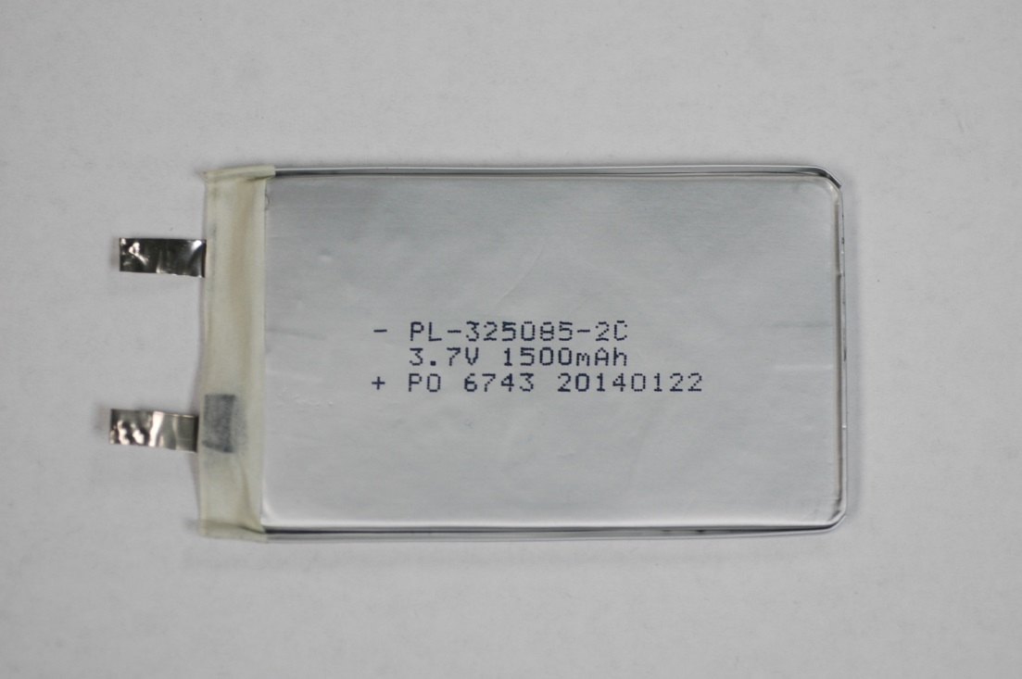
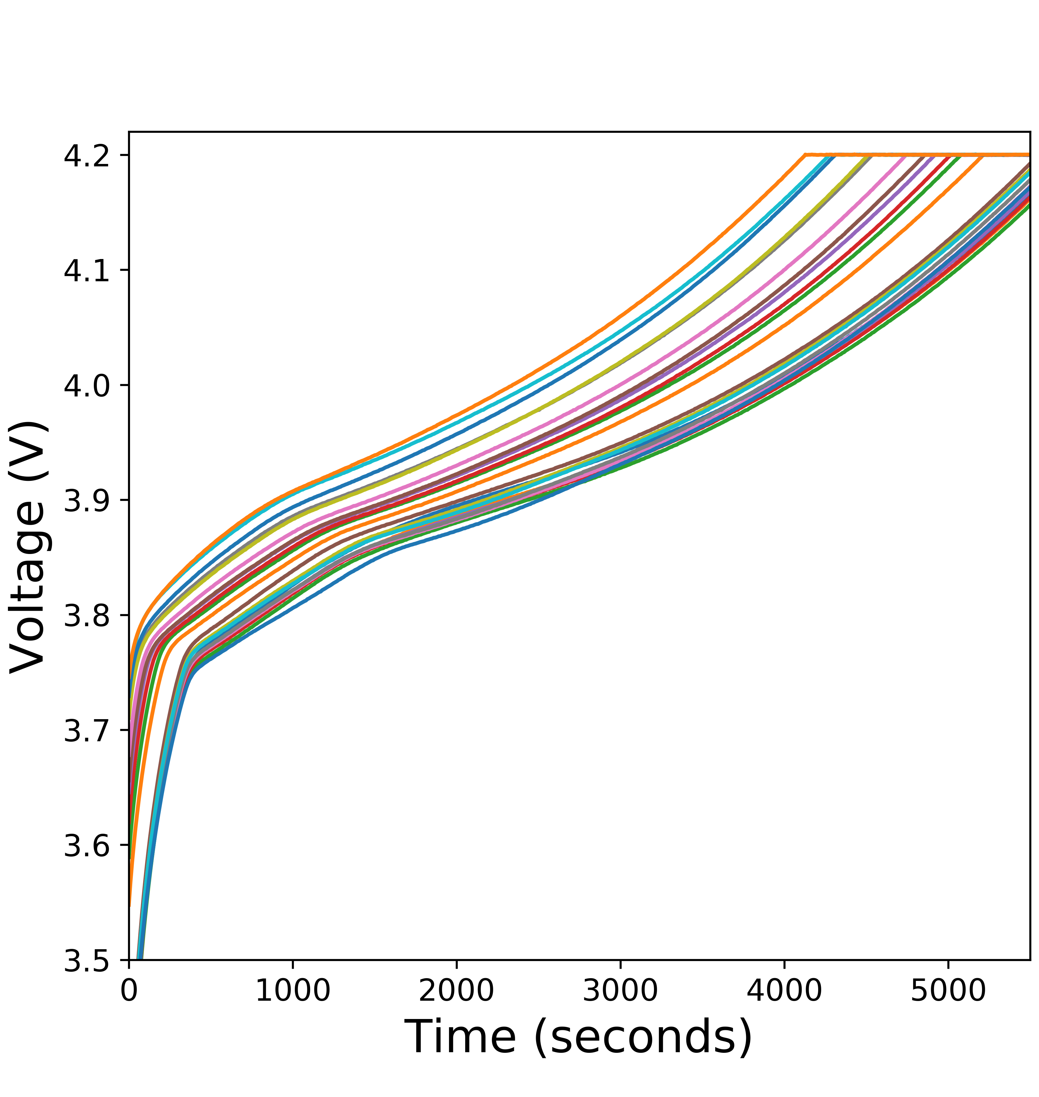
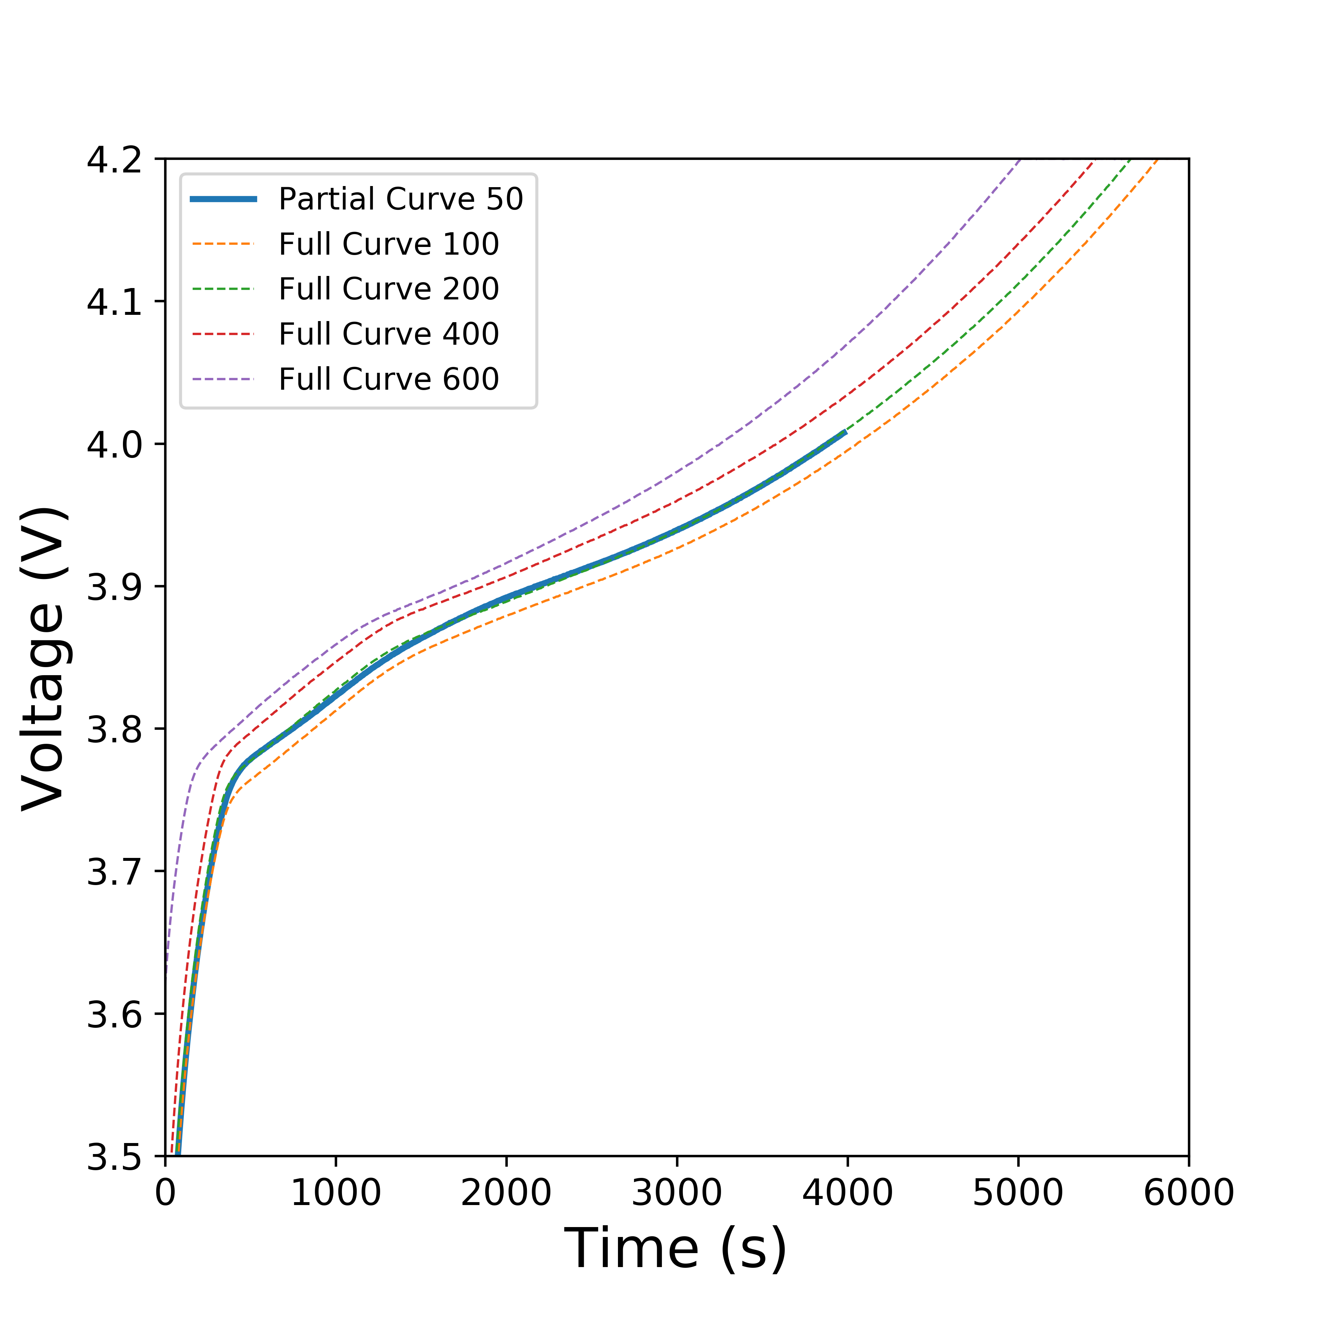
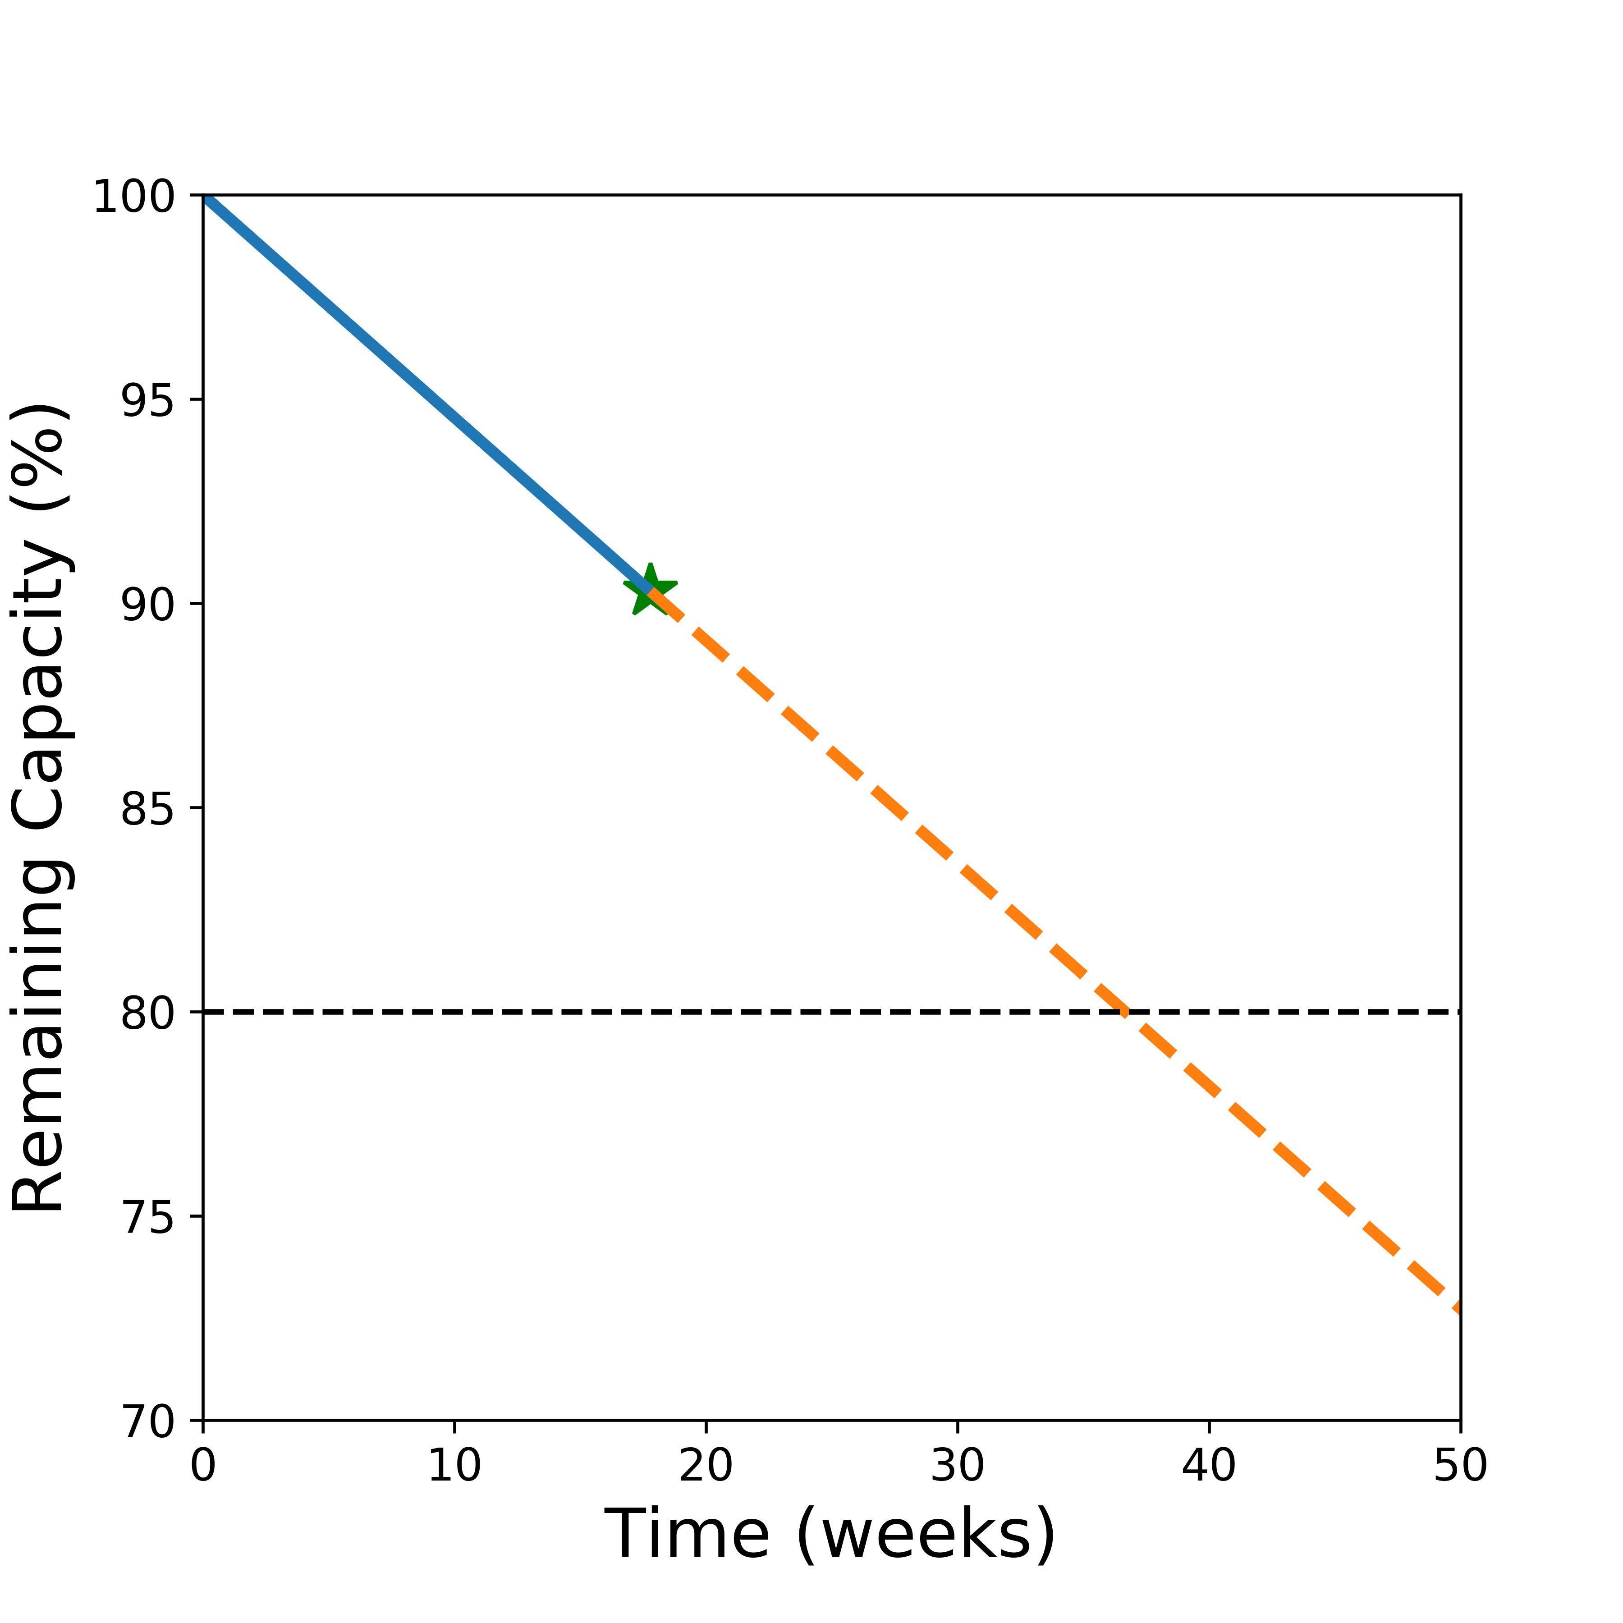

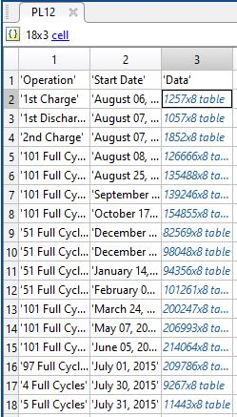
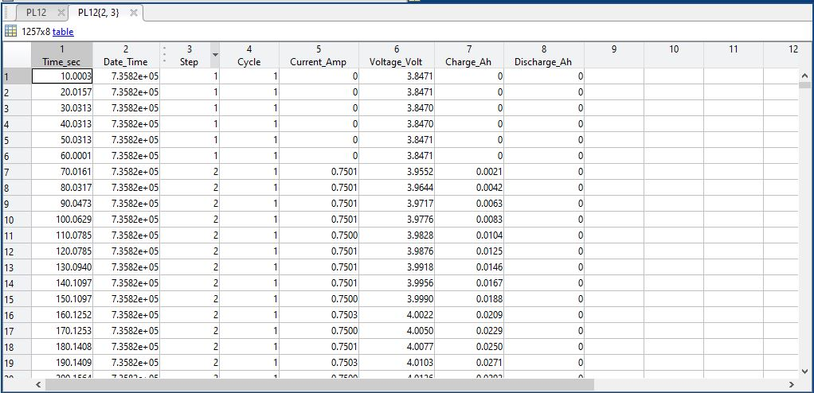

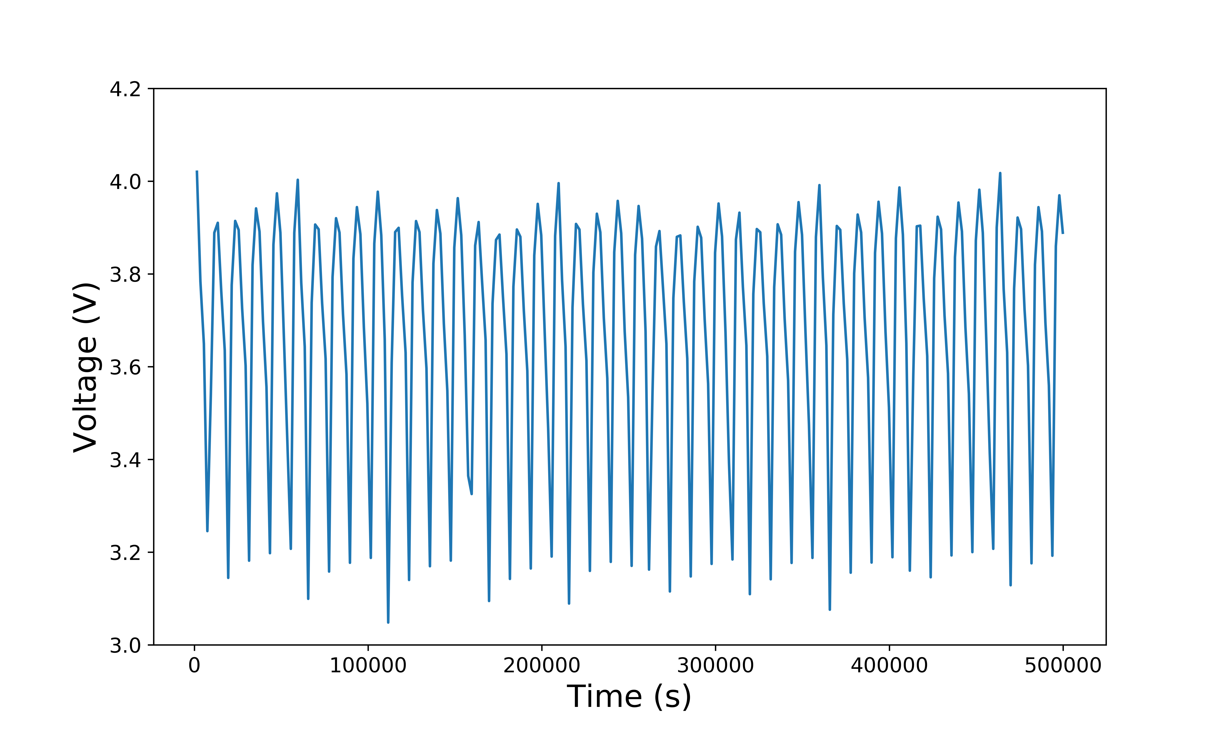
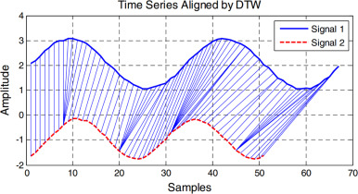






Predicting usable lifetime of lithium-ion batteries
Victor W. Hu, Yusong Liu, Rossana Scavone, Maitri Uppaluri
What Is PULOLB?
How Does The Package Work?
PULOLB is a software package, developed in Python, that can predict the remaining usable lifetime of a lithium-ion battery.
Knowledge of the current state of a device’s battery is important to users. To accurately assess these states, time-intensive procedures often have to be done. However, PULOLB can grant access to that information, in a shorter time frame.
Using long-term experimental, full-cycling data of the battery in question, the software is designed to allow a user to estimate the current state of their device’s battery when the battery has been partially charged and discharged over a shallower depth of discharge.
predict_capacity:
distance_cycle_to_full:
partial_to_full:
get_capacity:
get_lifetime:
The calce PL samples can be used by the predict_capacity module to estimate the capacity and the lifetime of the user’s battery based on a single partial cycle of the same battery and same C- cycling rates.
The distance between the two time series is calculated using Dynamic Time-Warping and with the KNN algorithms, the full curve that has the shortest Euclidean distance to the partial curve gives its cycle number.
The given set of partial charge or discharge curve is fitted into the library of full curves. For each partial curve, the algorithm predicts closest resembling full cycle curve and returns that cycle number.
Once the corresponding cycle number is predicted, the capacity of the battery is determined. The lifetime of the battery can be calculated from the capacity.
The package returns the current battery status and predicts when the battery will reach 80 % of its rated capacity, a common metric of the remaining lifetime, based on the time of the first cycle and the cycle of interest.
Percentage of remaining capacity of the battery.
Polymer lithium-ion pouch cell
(LiCoO₂ | C₆)
import_data:
Data Cleaning
Full charge cycles of a pouch lithium ion battery at a constant C/2 rate. The cycles shown are from cycle 0 to cycle 900. It is evident that at high cycle numbers, the battery has lost appreciable capacity.
The partial curve, shown in a thicker line, is plotted against multiple full curves for comparison. Through the algorithm, it is expected this partial curve is most related to the state of the 200th full cycle.
Prediction of the battery’s lifetime.
Create a GUI for the user to input data more effectively.
Expand the import_data function to allow different kinds of input files to be read and implemented.
Improve speed of the code by trying other machine learning algorithms.
Improve the accuracy of the cycle, capacity and lifetime prediction of the battery.
Better methods to extrapolate data for a more accurate prediction of the battery’s lifetime.
Packages Used To Develop The Machine Learning Code
Future Work
Partial cycling data (C/2 rate) of a PL sample from the CALCE database after the data has been cleaned and imported into Python
Packages used for data cleaning:
Dynamic Time Warping
hdf5storage:
A package that can read/write HDF5 (Hierarchical Data Format) files. The data is classified into HDF5 groups, which contain HDF5 datasets that can be read as NumPy arrays. Each dataset is stored inside a dictionary.
h5py:
Required for full functionality of hdf5storage.
The distance between the two time series are calculated using DTW. For this project, the Euclidean distance between the two time series was calculated.
Functions used to clean the data:
import_data:
Converts the .mat files into a single Pandas DataFrame, where all the data in the tables are unpacked, and the cycles are properly annotated
sort_data:
Sorts the data in the pandas dataframe by cycle number, stores this data as a dictionary with the cycle number as the key.
Separates the charge and discharge data by their respective cycles.
single_pd_matlab_data:
by_cycle:
Salvador, S. & Chan, P. FastDTW: Toward Accurate Dynamic Time Warping in Linear Time and Space.
Lu, B., Xu, S., Stuber, J. & Edgar, T. Constrained selective dynamic time warping of trajectories in three dimensional batch data - ScienceDirect.
charge_discharge:
References

